Slide 1
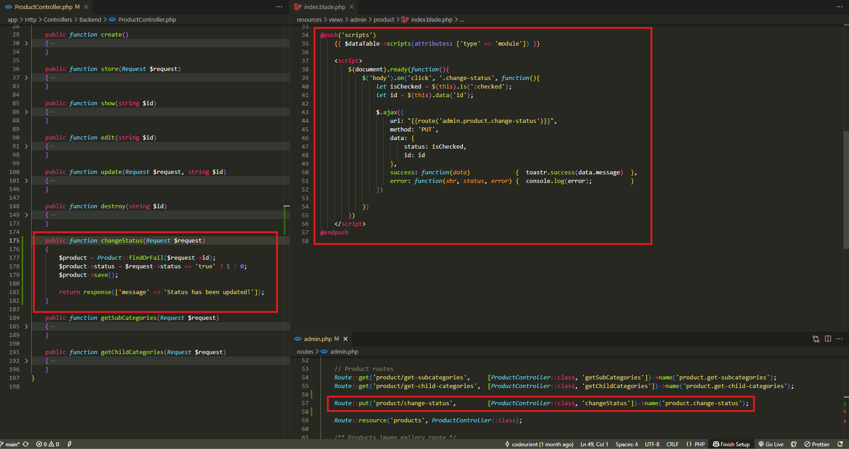
app\Http\Controllers\Backend\ProductController.php
resources\views\admin\product\index.blade.php

Slide 2
.

Slide 3
.

Slide 4
.

Slide 5
.

